Slide 1


Hope to Skills
Lecture# 16
Irfan Malik, Dr. Sheraz Naseer

Slide 2
Agenda
Classification
Dependent vs Independent Variable
Logistic Regression
Data Splitting
Scikit Learn
Quiz

Slide 3
Classification
Classification is a machine learning technique used to predict categorical or discrete target variables.
Types of classification problems: binary (two classes) and multi-class (more than two classes).
Add example of binary classes

Slide 4
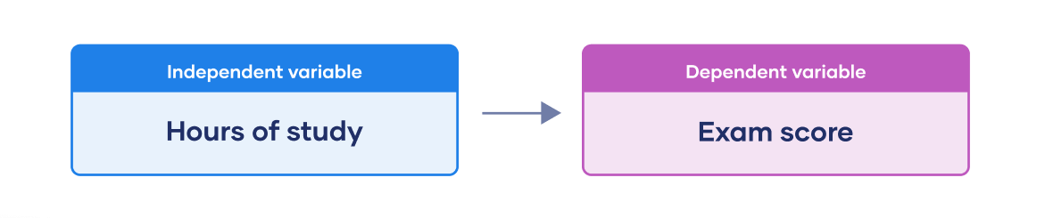
Dependent vs independent Variable

Slide 5
Dependent vs independent Variable
Dependent Variable (DV): The outcome or response variable we want to explain or predict.
Example: Test scores are the dependent variable in a study investigating the effect of study hours on performance.
Independent Variable (IV): The variable that is manipulated or changed to observe its effect on the dependent variable.
Example: Study hours are the independent variable in the same study.

Slide 6
Regression
Regression is a statistical technique used to model the relationship between a dependent variable and one or more independent variables
The dependent variable is often referred to as the "outcome" or "target", while the independent variables are called "variables" or "features".

Slide 7
Regression vs correlation
Aspect | Regression | Correlation
Purpose | Predict the value of the dependent variable based on independent variables. | Assess the strength and direction of the linear relationship between variables.
Type of Analysis | Predictive and explanatory modeling. | Descriptive analysis of relations.
Output | Provides the values (Probability) which represents the effect | Gives a single value (correlation coefficient) representing the strength of the relationship.

Slide 8
Logistic Regression
Logistic Regression is a type of analysis used for predicting binary outcomes (two categories).
Example: Predicting whether a student will pass (1) or fail (0) an exam based on study hours

Slide 9
Medical Diagnosis (Example)
Output: Logistic regression yields the probability of a patient having a medical condition.
Interpretation: A probability of 0.70 means the model is 70% confident in the diagnosis, 0.30 means 30% confident in a negative diagnosis.
Decision: Physicians use probabilities for informed diagnostic decisions and treatments.

Slide 10
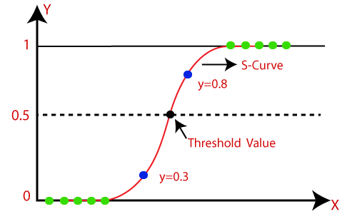
Logistic Regression
dependent Variable
Independent Variable

Slide 11
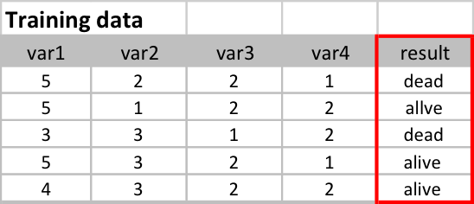
Selecting the Target Variable
The target variable is the variable we want to predict/classify.
It represents the outcome or label we are interested in.
Choose a meaningful target variable based on the problem at hand.

Slide 12
Lets move to Google collab

